Slide 1
HAPPINESS
Melissa Morgan
Godwin Thomas
Julia Thompson
Blake Skinner
GROUP 6

Slide 2


Slide 3
Happiest Cities in America Mar 11, 2019 | Adam McCann, Financial Writer
Happiest Cities in America Study
Published by WalletHub
Resulted in list of 182 cities
Ranked by each city’s total happiness score
Methodology
Selection of Cities
150 most populated U.S. cities
Plus at least two of the most populated cities in each state
Compared cities across three key dimensions:
Emotional & Physical Well-Being
Income & Employment
Community & Environment

Slide 4
Data Gathering & Cleaning

Slide 5
Gathering & Cleaning Data
Gathering the Data / Sources
Google Geocode API
Dark Sky API
Summary - A human-readable text summary of this data point.
Icon - A machine-readable text summary of this data point, suitable for selecting an icon for display.
Sunrise time - The UNIX time of when the sun will rise during a given day.
Sunset time - The UNIX time of when the sun will set during a given day.
Cloud cover - The percentage of sky occluded by clouds, between 0 and 1, inclusive.
UV index - The UV index.
Cleaning the Data
Continental United States
Missing Data

Slide 6
Data analysis
Complete Population

Slide 7
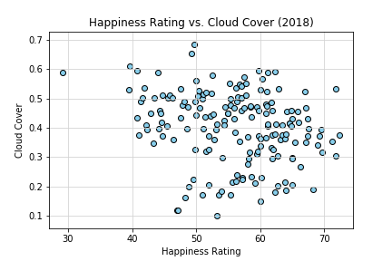
Happiness Rating vs. Cloud Cover
Happiness Rating vs Cloud Cover shows no correlation via scatterplot

Slide 8
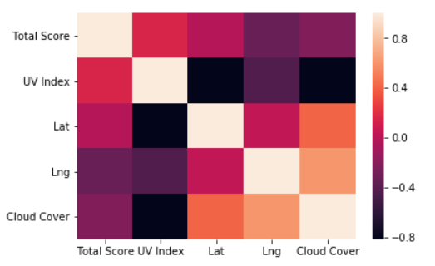
Correlation Heat Map
Correlation heatmap illustrates “Longitude” having strongest correlation to the Happiness Rating as a negative correlation with an R2 = 0.1119
Followed by the next strongest which is Cloud Cover with an R2=0.05258

Slide 9
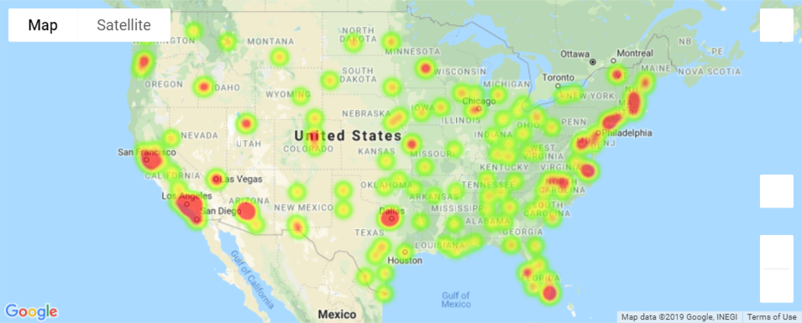
Happiness Rating vs. Location
Heat map represents all 178 cities

Slide 10
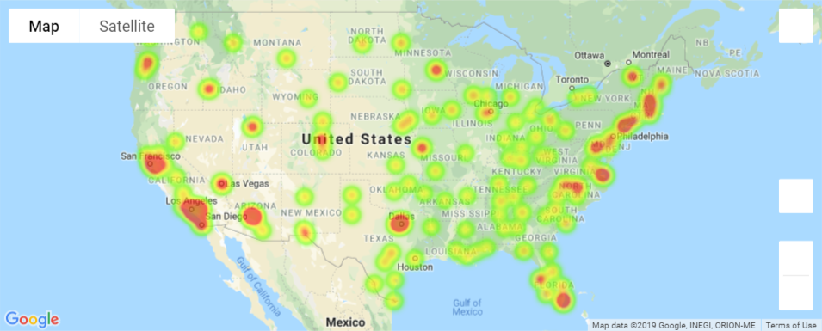
Heat Map Including Cloud Coverage

Slide 11
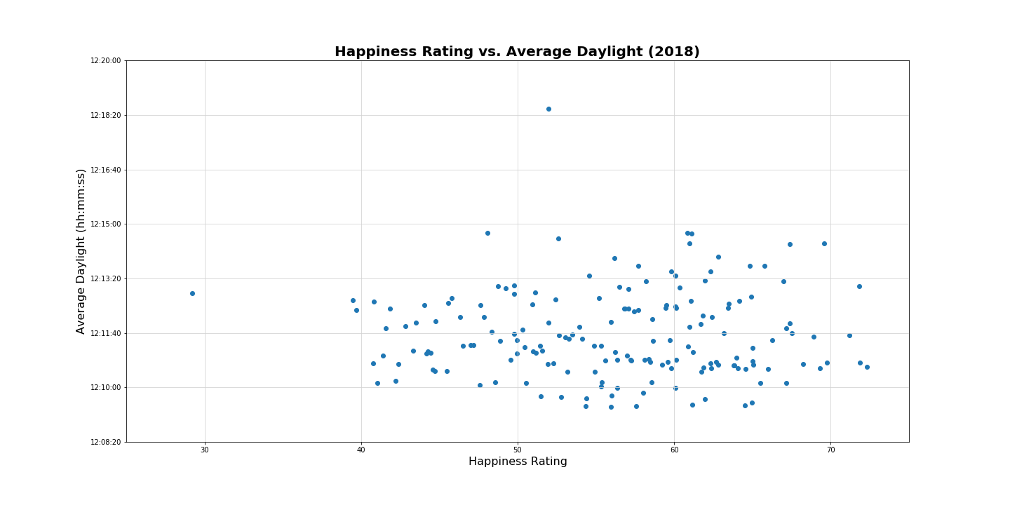
Average Daylight Hours

Slide 12
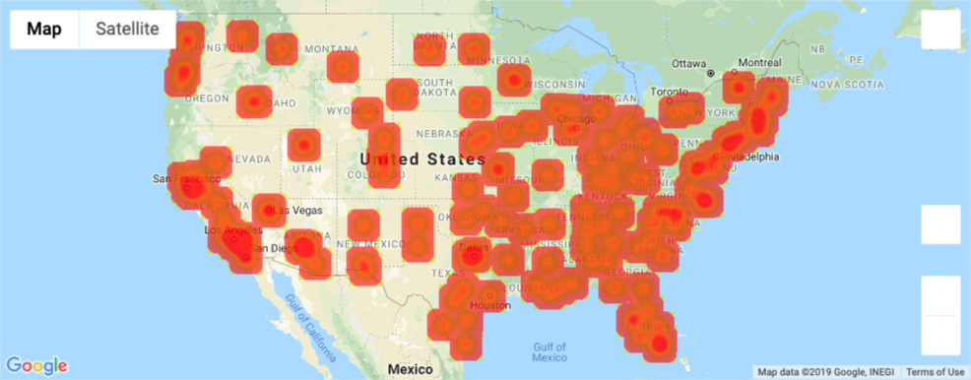
Heat Map – Average Daylight Seconds
There was no correlation between daylight hours and the happiness index

Slide 13
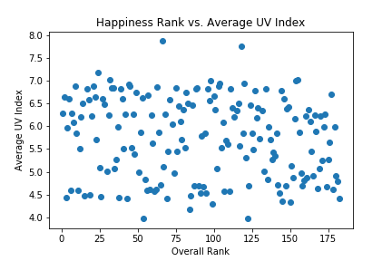
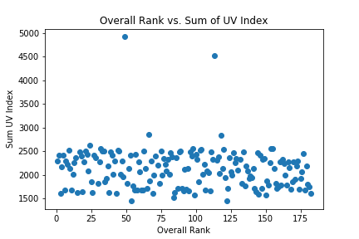
Overall Rank vs. UV Index
Comparison of overall rank (1=Best) against the Average UV Index per year.
As anticipated, there is not enough evidence to conclude that the Average UV Index has an impact on a city’s overall rank.

Slide 14
Top & Bottom 25 Cities
Based on Happiness Rankings

Slide 15
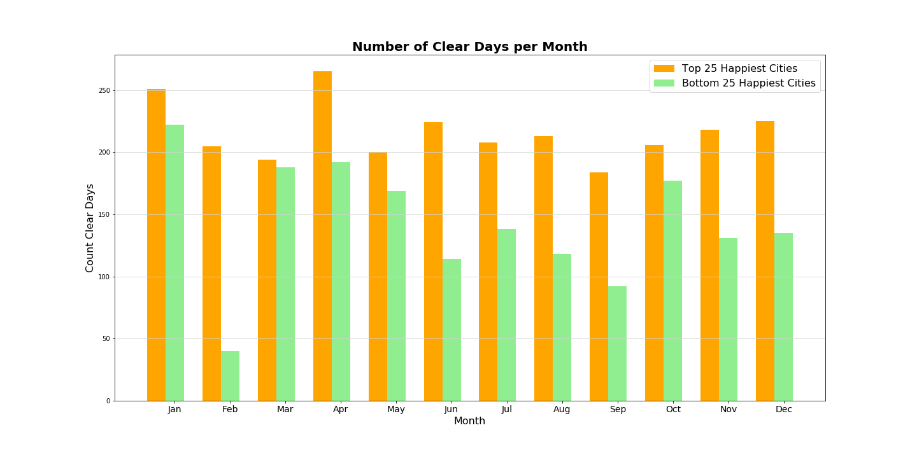
Number of Clear Days per Month

Slide 16
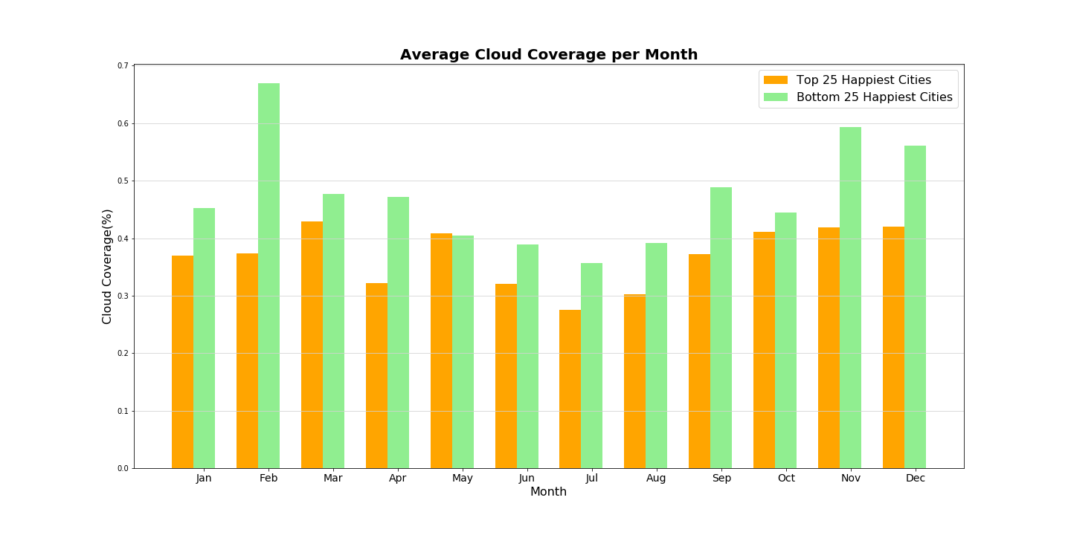
Average Cloud Coverage Per Month

Slide 17
conclusion

Slide 18

Q&A
“The purpose of our lives is to be happy.”
Dalai Lama

